Slide 1

AI Engineer Agentic Track
The Complete
Agent & MCP
Course
Week 5
Day 5

Slide 2
Week 6: MCP
Agentic
Architecture
and MCP
Building an
MCP Server
and Client
Multiple Local
and Remote
MCP servers
Project 8: AI
Equity Traders
Project 8: AI
Equity Traders
In Action
Week 5: Agent Frameworks
Google ADK and A2A
Strands and Pydantic AI
MAF and
Agno
Mastra
Project 7:
Agent
Loop
Week 4: LangGraph
LangChain Core
LangGraph
LangChain
create_agent
Deep Agents
Project 6:
Sidekick
Week 3: CrewAI
Understand
Crew AI
Concepts
Build a Crew
Agent
Project 4: Stock
Picker
Project 5:
Developer
Agent
Project 5:
Engineering
Team
Week 2: OpenAI Agents SDK
Understand
OpenAI Agents
SDK concepts
Project 2: an
SDR
Tools vs Agents
Guardrails
Project 3: Deep
Research
Project 3: Deep
Research app
Week 1: Foundations
Make an
Agentic
Workflow
Agents and
Agentic
Patterns
Orchestrating
LLMs
Autonomy and
Tools
Project 1:
Your personal
career agent

Slide 3
Six frameworks, one shape
Know one, know them all
Framework | Create | Add a tool | Run
Google ADK | LlmAgent(...) | plain fn | run_async
AWS Strands | Agent(...) | @tool | invoke_async
Pydantic AI | Agent(...) | plain fn | agent.run()
MS Agent Framework | Agent(...) | plain fn | agent.run()
Agno | Agent(...) | plain fn | agent.arun()
Mastra | new Agent({...}) | createTool | agent.generate()

Slide 4
What actually differs
The small print
Default model ADK runs on Gemini, the other five on OpenAI gpt-5.4-mini in our labs
Dev runtime adk web, Mastra Studio and Agno AgentOS each give a live trace UI
Typed output all six return validated results, cleanest in Pydantic AI
Language five are Python, Mastra is TypeScript on Node, same idioms either way
Orchestration ADK and MAF ship workflow graphs, the lighter ones leave it to you

Slide 5

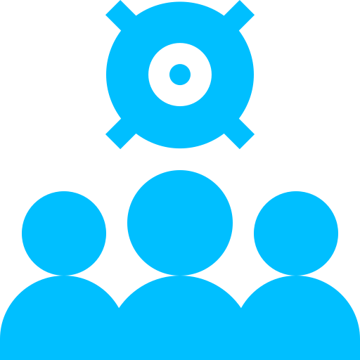

Project 7: the Agent Loop
Five frameworks build it, one agent runs the show
The brief name a language, the team builds a playable arcade that teaches it
Five builders each builds a mini-game in parallel, all writing to one shared board
An outer loop the orchestrator judges each game in a real browser and sends one fix

Slide 6
How it fits together
Nested loops: outer Agent loop runs the inner agent loops
ADK orchestrator
decides, launches, judges, repairs
the outer loop
launches in parallel
Strands
Pydantic AI
MAF
Agno
Mastra
write
Shared SQLite board
one file, six processes, the only coordination channel
opens each game to judge
Browser QA agent
plays each game in real Chrome via Playwright
Agent Architecture was driven by outcomes…
No need for A2A to communicate between our own Agents

Slide 7
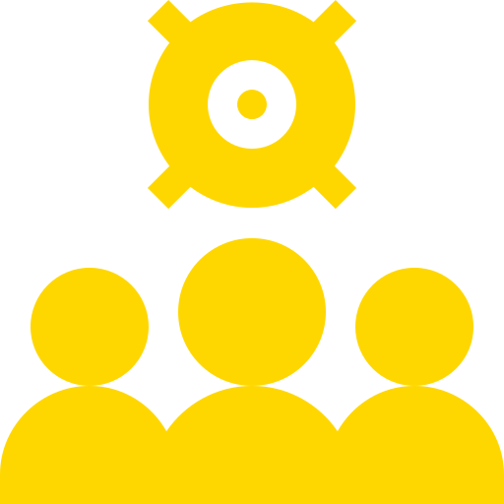
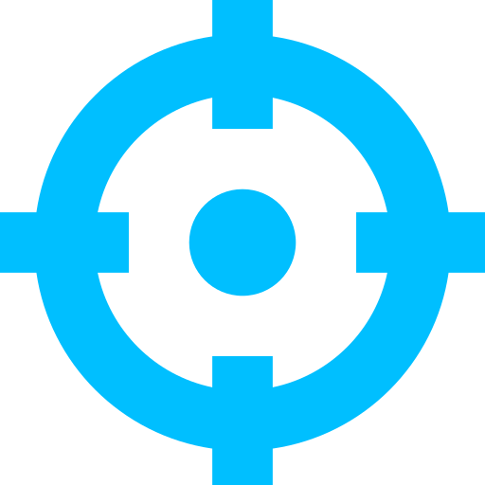
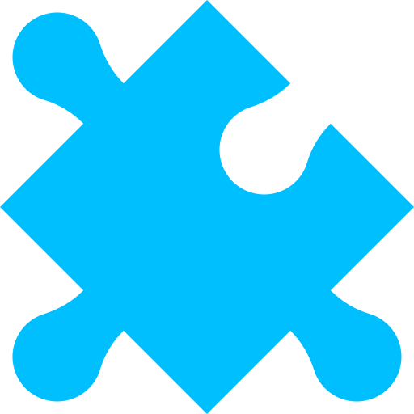

Make it your own
Your end-of-week challenge
Reuse the team keep the ADK orchestrator and the five framework workers on the shared board
Pick a domain swap the language-tutor site for a new useful output you care about
Specialise each give every framework-agent a distinct role and a piece to build
Run in parallel seed tasks on the SQLite board and watch the workers build at once
…And give a broader, measurable objective and have the Orchestrator keep looping until achieved

Slide 8
Week 6: MCP
Agentic
Architecture
and MCP
Building an
MCP Server
and Client
Multiple Local
and Remote
MCP servers
Project 8: AI
Equity Traders
Project 8: AI
Equity Traders
In Action
Week 5: Agent Frameworks
Google ADK and A2A
Strands and Pydantic AI
MAF and
Agno
Mastra
Project 7:
Agent
Loop
Week 4: LangGraph
LangChain Core
LangGraph
LangChain
create_agent
Deep Agents
Project 6:
Sidekick
Week 3: CrewAI
Understand
Crew AI
Concepts
Build a Crew
Agent
Project 4: Stock
Picker
Project 5:
Developer
Agent
Project 5:
Engineering
Team
Week 2: OpenAI Agents SDK
Understand
OpenAI Agents
SDK concepts
Project 2: an
SDR
Tools vs Agents
Guardrails
Project 3: Deep
Research
Project 3: Deep
Research app
Week 1: Foundations
Make an
Agentic
Workflow
Agents and
Agentic
Patterns
Orchestrating
LLMs
Autonomy and
Tools
Project 1:
Your personal
career agent

Slide 9

AI Engineer Agentic Track
The Complete
Agent & MCP
Course
83%
Complete

